Slide 1
Introduction to HDF5
Session Four
Java Products
Copyright © 2010 The HDF Group. All Rights Reserved

Slide 2


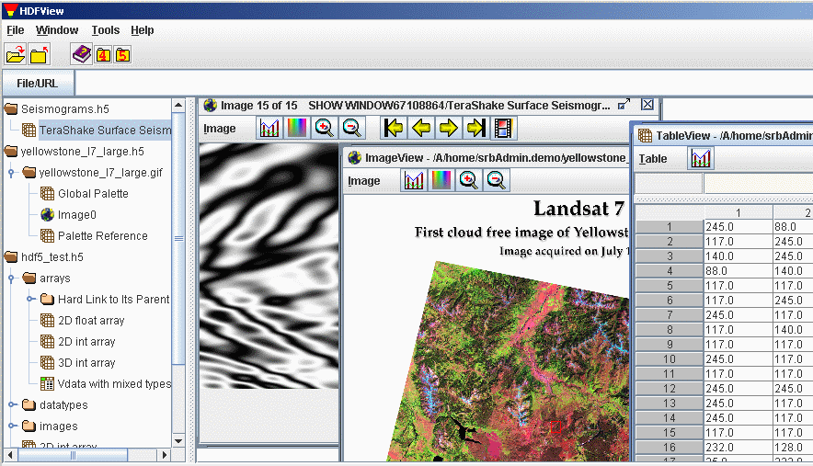
HDF5 Java Products
HDF
Java
Wrapper
Object
Package
Viewer
Editor
Copyright © 2010 The HDF Group. All Rights Reserved

Slide 3



Java Wrapper or Native Library?
Pure Java
Library
HDF
JNI
a programming framework that allows Java code to call and be called by applications and libraries written in other languages
NetCDF-Java library
HDF
Copyright © 2010 The HDF Group. All Rights Reserved

Slide 4
Pure Java Library
Pros:
  True platform independence
  Direct access to file (no data conversion between C and Java)
Pure Java
Library
Cons:
  Substantial amount of work to support existing features in the C library.
  Duplicates development effort in C
HDF
Copyright © 2010 The HDF Group. All Rights Reserved

Slide 5
HDF JNI
Pros:
  Easy to implement
  Easy to keep up with the library changes
HDF
Cons:
  Requires data conversion between C and Java
  The JNI is platform dependent
HDF
Copyright © 2010 The HDF Group. All Rights Reserved

Slide 6
Java Wrapper
Java
C
C Native
Impl.
HDF
H5.java
h5Imp.c
Copyright © 2010 The HDF Group. All Rights Reserved

Slide 7
Java Wrapper: File Open in Java and C
Java
C
public static native int
H5Fopen (
String name,
int flags,
int access_id);
hid_t
H5Fopen (
const char *name,
unsigned flags,
hid_t access_id );
Copyright © 2010 The HDF Group. All Rights Reserved

Slide 8
Java Wrapper: Reading Data
A very simple example.
int fid, did, sid, tid, rank;
long dims[], maxDims[];
Object theData;
fid = H5.H5Fopen( fname, HDF5Constants.H5F_ACC_RDWR, HDF5Constants.H5P_DEFAULT);
did = H5.H5Dopen(fid, dname);
sid = H5.H5Dget_space(did);
tid = H5.H5Dget_type(did);
rank = H5.H5Sget_simple_extent_ndims(sid);
dims = new long[rank];
maxDims = new long[rank];
H5.H5Sget_simple_extent_dims(sid, dims, maxDims);
theData = allocateArray(tid, dims);
H5.H5Dread( did, tid, HDF5Constants.H5S_ALL, HDF5Constants.H5S_ALL HDF5Constants.H5P_DEFAULT, theData);
H5.H5Sclose(sid);
H5.H5Tclose(tid);
H5.H5Dclose(did);
H5.H5Fclose(fid);
Is there an easy way?
Copyright © 2010 The HDF Group. All Rights Reserved

Slide 9

Object Package: The easy way…
theData = Dataset.read();
For application developers:
  Less function calls
  Easy to extend for specific needs
Copyright © 2010 The HDF Group. All Rights Reserved

Slide 10

Object Package: Basic Classes
File
Group
Dataset
Datatype
Attribute
http://www.hdfgroup.org/hdf-java-html/hdf-object/
Copyright © 2010 The HDF Group. All Rights Reserved

Slide 11
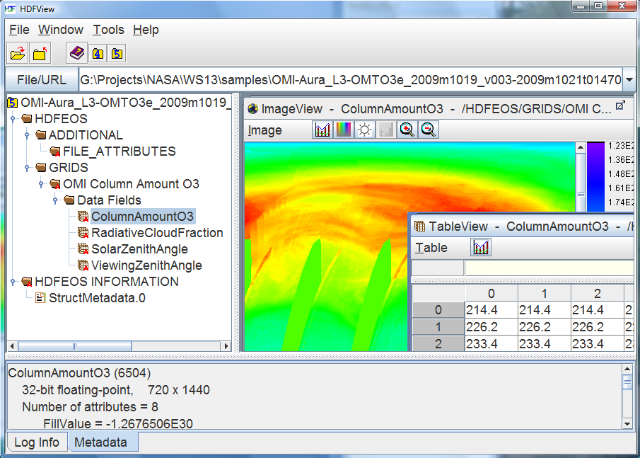
HDFView
Copyright © 2010 The HDF Group. All Rights Reserved

Slide 12
Limitations of HDF-Java Products
No support for HDF5 API routines with callbacks
Some HDF5 datatype features not supported:
  Unsigned integer datatypes
  Nested compound datatype creation
JVM resource limits can restrict operations
Some “low priority” C API routines not covered:
  http://www.hdfgroup.uiuc.edu/RFC/HDF5/hdf-java/
“High level” C API routines not covered:
  Dimension scales, Images, Tables, etc.
Copyright © 2010 The HDF Group. All Rights Reserved

Slide 13
Multiple Dimensions in Java
1-D arrays map directly from Java to C
  float a = new float[1000]
Multi-Dimensional arrays ( > 1D) are arrays of objects
  float b = new float[100][100]
  Allowed, but very slow currently
  Suggest using 1-D array for I/O and mapping to multi-D in application
Copyright © 2010 The HDF Group. All Rights Reserved

Slide 14

Stretch Break
Copyright © 2010 The HDF Group. All Rights Reserved

